Slide 1

Leadership Principles Behavioral Interview
Amazon

Slide 2
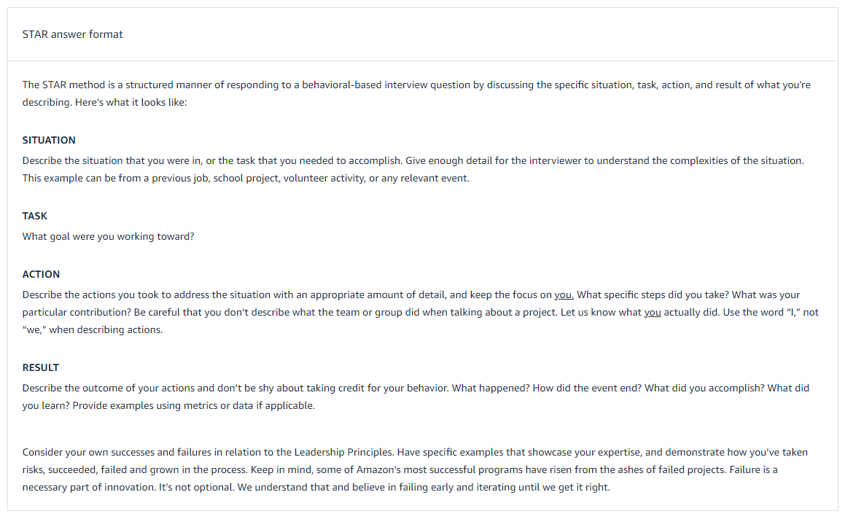
Perfecting START Method
https://www.amazon.jobs/pt/landing_pages/in-person-interview

Slide 3
Perfecting START Method - Situation
  Pick example with the
    Highest level of complexity and ambiguity of problem
    Simplicity of solution
    Seniority of decision-makers and customer/business impact that YOU have
  Make sure to answer the question that was asked. Example if the interviewer asked to describe a complex problem, try not to respond with something that someone in your capacity solves on a weekly basis.
    Make sure you have 2 situations per LP
    If you are not sure ask clarification question to interviewer

Slide 4
Perfecting STAR Method - Task
What goal were you working toward?
  How would you know you were successful?
    Find objectives, KPIs and deadlines
  How do you know KPI really matters?
    KPIs need to be justified
  Are you in risk confusing the interviewer?
    Focus on the main KPI
  Mention obstacles that you could anticipate, mention them here (Do not invent them but don’t miss opportunity to mention obstacles if you experienced)

Slide 5
Perfecting START Method - Action
Avoid “We” use “I” - Use “we” to describe the proverbial boat that you were on. But when you took the helm to steer it through the storm, use “I”
Create a mental numbered list of concrete steps that you took

Slide 6
Perfecting STAR Method - Result
Always have measurable results to share. Even if binary or anecdotal. Avoid picking situations where there are no measurable results.
Share lessons learned regardless of successful or failure outcomes.
Make sure the results tie to the KPIs from the “Task” section.

Slide 7
Perfecting START Method – Ideal flow
Ask the interviewer for a couple of minutes to gather your thoughts.
Avoid monologue, open with a 4-minute situation compressed in a STAR narrative. Offer enough facts to demonstrate your knowledge of the details.
Welcome follow-ups and drill-downs ( this is signal that interviewer is taking interest on your example)
Ask meaningful questions at the end (15 minutes)
Notes:
Amazon is peculiar, Amazon believes in Working hard, having fun and making history.

Slide 8
Winning characteristics
Calm, confident, relaxed, engaged
Highly structured, logical and linear
Recognizes complexity but strives for simplicity
Highly articulate, crisp and to the point; does not loop around
Highly numerate; likes numbers (KPIs and Results should have numbers)
Use facts to make decisions and arguments
Don’t be apologetic but have healthy self-criticism
Explains and simplifies unknown industry concepts (Don’t use much technical terms, keep response more on behavior and humans)

Slide 9
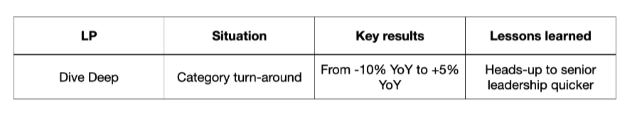
Arranging Logistics – Summary sheet
Create Situation summary sheet with LPs, situation prompts and key results/outcomes as well as lesson learned as per below template. Prepare at least 2 situation prompt per LP.

Slide 10
Arranging Logistics – Hardware software
Get proper headset
Download Amazon Chime and test your hardware in advance
Place a test conference call with a friend to test your internet connection.

Slide 11
Are Right A Lot
Tell me about a time when you made a difficult decision with input from many different sources such as customers, stakeholders and partner team and so forth
Tell me about a time when you made an error of judgement

Slide 12
Other Questions
Bias For Action: Tell me about a time when you had to make a decision without consulting your manager
Customer Obsession: Tell me about a time when you had a difficult interaction with customer
Invent & Simplify: Tell me about a time when you solved a complex problem with simple solution

Slide 13
Critical LPs Loop round
SA Level 5 and Level 6
Customer Obsession,
Deliver Results,
Invent and Simplify,
Have Backbone
Disagree and Commit
Learn and Be Curious
Think Big
Earn Trust (83% of loops)
Dive Deep (77%)

